Slide 1


A Complete Society Management System
Notes:
NESTIN simplify the complexities of RWA operations and helps build a better communication system between the residents and RWA

Slide 2
ABOUT NESTIN
Helps manage Housing Society.
By connecting and involving residents.
Code Access Security
Managing Services.
Residents Participation
Increased Communication
Notes:
Nestin .. A society management system

Slide 3
OUR VISION
1
Coordination and Communications among Residents.
Information management
with data History
3
2
Safe and Secure Community living
4
Well-integrated environment and help improve RWA operations
Notes:
Our vision

Slide 4
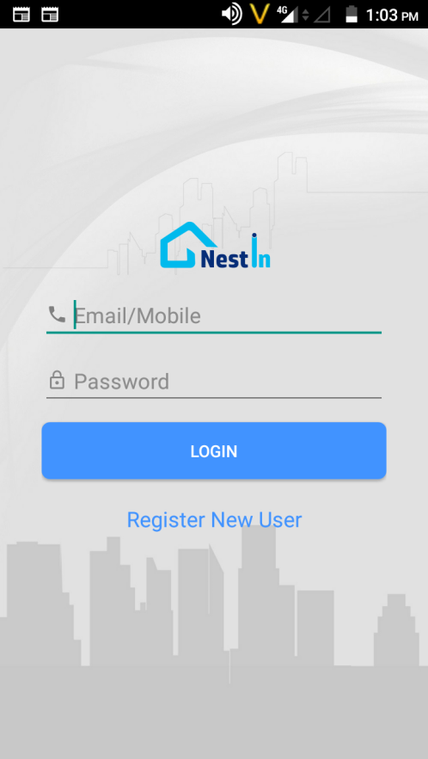
NESTIN the right solution..
User Friendly
No complex or fancy,
simple and easy for everyone to use
One Stop Solution
Community Requirements,
RWA Operations,
Individual needs
Evolving
Evolving as per user feedback and need.
Forward Looking
Looking to get more integration to enhance community living
Customization
Open to address specific Problems
Customer Support
Dedicated customer support.
Notes:
Why Choose Us?

Slide 5





for all your society
management requirements
• Services
Visitor Management
RWA Notice Board
Forum & Discussion
Ride Share
Vendor Directory
Vendor – Offers & Schemes
Rent in & Rent Out
Bills Management
Notes:
Nestin a complete solution to all your problems…. Making everyday life easy and efficient in gated communities

Slide 6
Owner/ Tenant records
Society
FLAT
Admin
Admin Add Flats
Owner Register to Flat – Admin Approves
Owner Add Tenant.
Owner Remove Tenant
Owner
Tenant
Employee
Notes:
Now manage large complex tenant's data easily, disseminate important notice to all the residents in one go! Forget worrying about maintaining a register for bill payments and dues. NESTIN!! empowering your society digitally.

Slide 7
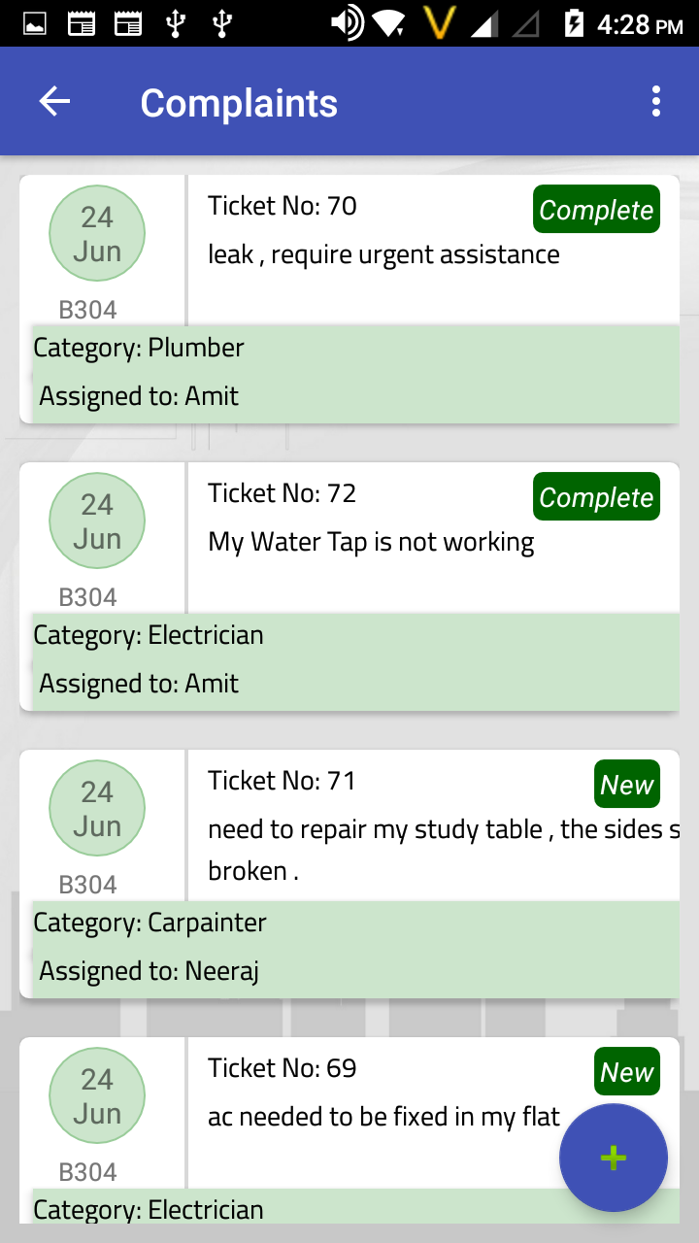
Complaint
Residents can raise complaint using Web and mobile interface anytime anywhere,
Automatic assignment to concerned person.
Employee will Get Message
Notes:
Now know what's happening in your society with a click, get update on vendors and rate services, auto assign complaints to the concerned personnel, pay and maintain bills easily.

Slide 8
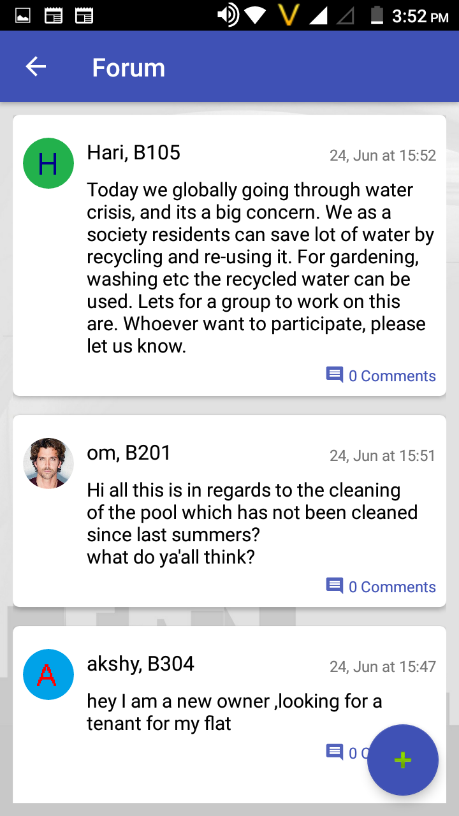
Forum & Discussion
Residents can use this internal discussion platforms for sharing views and information.
Residents need discussion and brain storming for future decision making or may be taking initiative like garbage handling, plantation, future events or any other social topic.
Notes:
All the latest news, topic of discussion and share your opinion with everyone in the society..

Slide 9
Ride Share
Ride with people you trust
YES
YES
Riding Noida today. Anyone Interested to pool with me?
YES
.

Slide 10
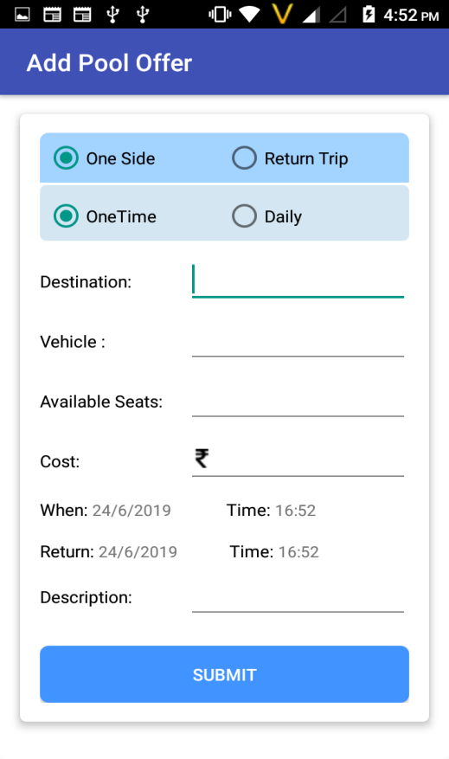
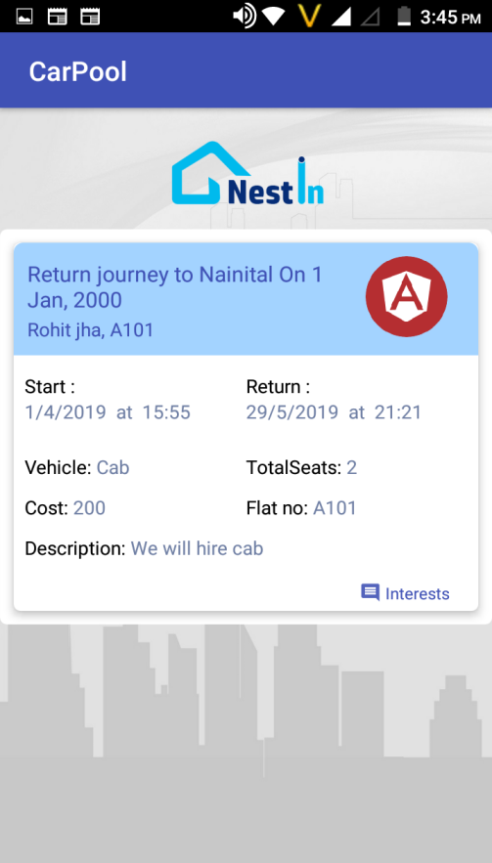
Ride Share it’s a simple process
Now ride with people from your society
Call the person who show interest and close the deal.
Happy Ride share
Its simple Add your pool offer
Select destination & negotiate on the price and submit

Slide 11
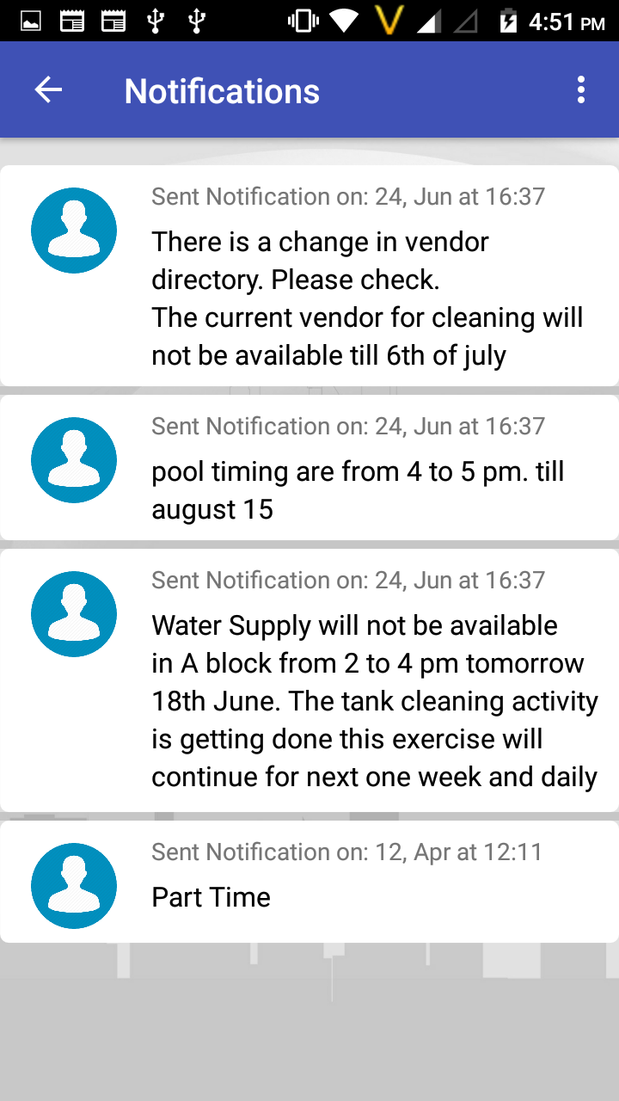
RWA - Notification
RWA Post Notifications on Notice Board
Residents do not regularly see Notice Board.
Missed many in cluster.
With Nestin.
All Notices are on your Mobile.
Can view them anytime-anywhere
Notes:
Get all the notification about important events and notice via call and sms on your smartphones

Slide 12
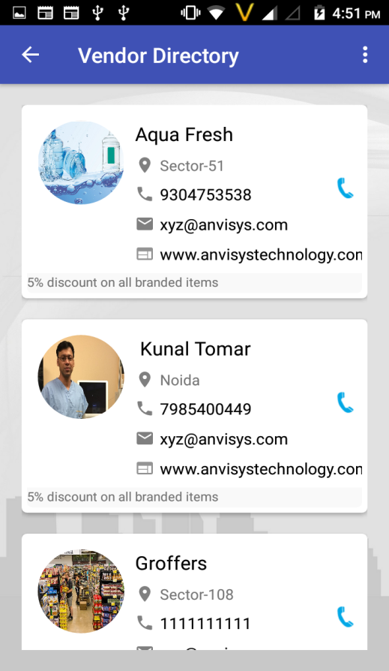
Vendors
Need vendor for daily needs –
Water suppliers, Newspaper Vendor, Milk Vendor etc.
Vendor Contact information –
Ask guard, neighbours or searching visiting cards.
With Nestin
Admin Register approved Vendors
Residents Get info on Mobile.
.
Notes:
Now upgrade your society with NESTIN. An app for all your day to day problems, from vendor management, advanced security system to share your ride feature and much more all in just one app.

Slide 13
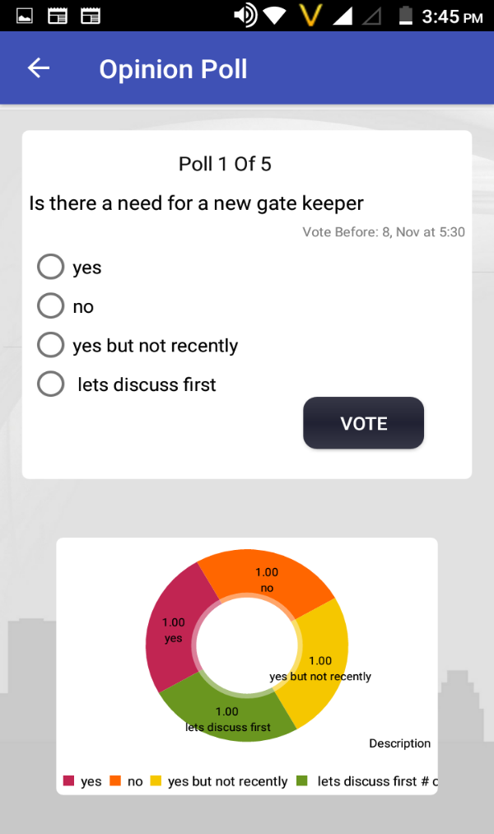
Opinion
Society Decision Needs people opinion
Meeting Dominated by Smart Residents
Want everybody’s opinion
Conduct a poll in your society before taking decision using Nestin.
.
I VOTE FOR IT
NO
YES
YES
Notes:
Vote and share your opinions via Opinion poll feature in Nestin app. Because your opinion matter’s

Slide 14
Security
****
Old Process
New Process
• Visitor / Guard calls from gate.
VS
• Enter Visitor data with Time in Application- Mobile or Web
• Make entry in Register
• Visitor gets on OTP on sms
• You takes call on Intercom
• If misses, Guest provide mobile
number to call
• At Guard tells OTP to Guard
• Guard verify OTP and allow check in
Notes:
Nestin replaces the old vary security process of your gated communities into a better efficient and safer system.

Slide 15



Benefits for the stakeholders
RWA’s
Residents
Vendors
Cost & Time Effective
Large data easily manage
Ride share
Better services
Discussion forum
Vendor’s variety
Manage all tenants records
Opinions polls
Notes:
The content needs to be changed kindly look into the slide as it’s content is from shobit.

Slide 16
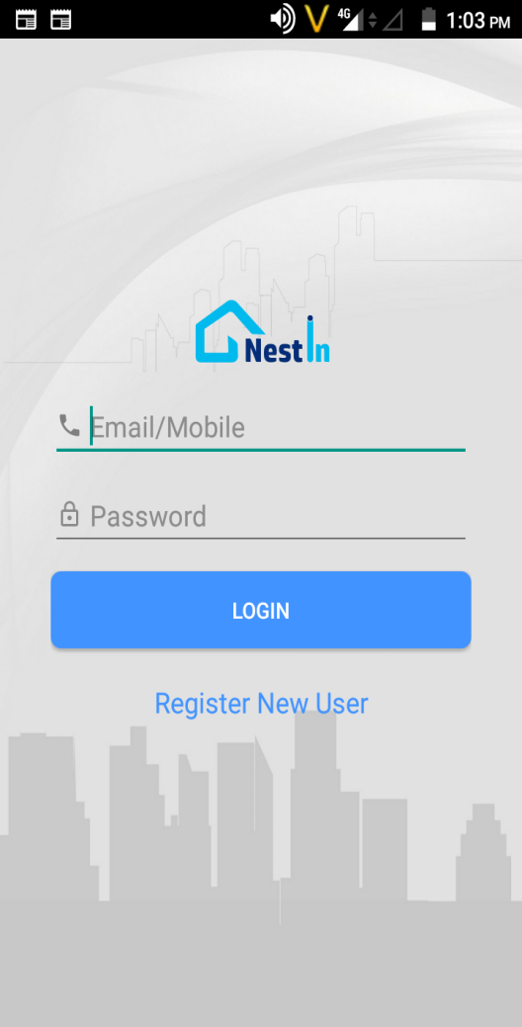
Product Features
Society Management Other Features
•Services/Complaints
• Rent in & Rent Out,
• Sale & Purchase
• Security/Guest Entry
• Notices and Information
• Bills and Payments
• Advertisements
• Discussion / Forum
• Vendor Registration
• Vendor Directory
• Opinion Polls

Slide 17


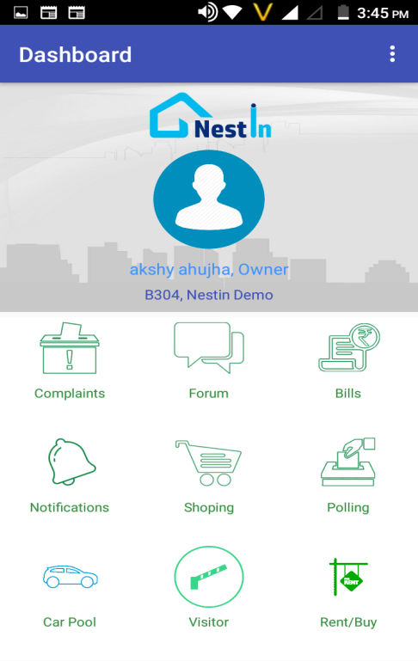
Why Societies should opt for a Society Management System?
Vendor Management.
Bills and Payments Management.
Notices and Information.
Discussion Forum.
Opinion Polls to vote over important decisions.
Security for society /Guest Entry.
Rent in & Rent Out.
Sale & Purchase.

Slide 18
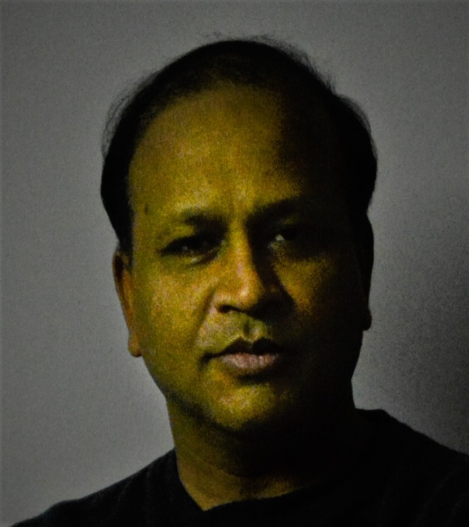
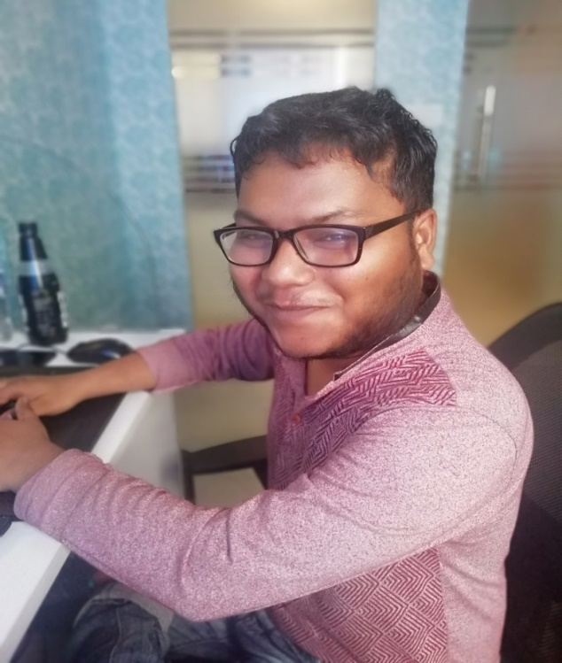

Amit Bansal
Sagar Srivastava
Shivang Bhatnagar
DI R EC T O R M.Tech.- IIT Roorkee
A N D O I D DEVE L O P E R
W E B DE V E LO P E R
B.E. Computer Science
B.E. Computer Science
18 Years Experience
3 Year Experience
2 Year Experience

Slide 19

Peaceful Homes

